Slide 1
Bellringer (10/23/2019)
Based on your reading in Fraser, what main event pushed American leaders to seek to revise the Articles of Confederation? Why?

Slide 2
Bellringer (11/18/2019)
Test your current knowledge about the Constitutional Convention (True or False):
1. The requirement in the Articles of Confederation that all 13 states had to agree on amendments led Congress to scrap it and create a new government.
2. The Constitutional Convention met in secrecy in Philadelphia in the summer months of 1787. They weren’t even allowed to tell their wives about what they discussed.
3. Thomas Jefferson was named president of the Convention.
4. The issue of representation led to the most heated debates among the delegates.
5. All 55 delegates at the convention signed the Constitution, a remarkable feat given the delegates’ differing views on proper government.
6. Rhode Island, not present at the Convention, was the last state to ratify the Constitution.
7. Convention delegates looked as far back as ancient history to guide them on creating the ideal form of government to protect freedom and liberty of the people.
8. The Constitution is the shortest-written and longest-lasting democratic government in world history.
Notes:
American History I—watch Making the Constitution (up to 23:46)

Slide 3
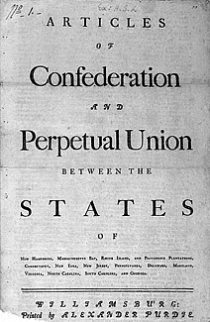
A Limited Government
Articles established a “firm league of friendship” among the states (loose federation)
Bills were passed only if nine of thirteen states agreed
Amending the Articles took unanimous consent of the states
Unicameral (single house) legislative body
No executive branch/temporary courts existed to hear disputes between states
Each state had one vote regardless of population
Notes:
The Articles established a government which it characterized as a “league of friendship” for common defense, communication with other nations, and to administer and operate the government. It was assumed that most legislation and enforcement of laws would occur within the states and that laws passed by the national Congress would only be to administer the powers it was given. Even so, any law passed would have to be carried by a “supermajority” of over 67 percent, with nine of thirteen states voting in the affirmative. To further insure that the central government would not be granted any increase in power, any amendment to the Articles needed the unanimous consent of all the states.
An executive committee oversaw government when Congress was not in session

Slide 4
Powers Denied to Articles of Conf.
No power to raise funds for an army or navy
No power to tax, impose tariffs, or collect duties
No executive branch to enforce laws
No power to control trade among the states
No power to force states to honor obligations
No power to regulate the value of currency
Notes:
The Articles didn’t provide the government with enough authority to fully carry out the tasks it was given. Though Congress could declare war and raise military forces, it couldn’t pay for them because it lacked the power to tax. Congress could requisition funds from the states, but had no power to make them part with their money. Congress could borrow money, but had no way to raise funds to pay off the debt except to ask the states for funds. If a state disagreed with the way Congress spent the funds, it would refuse or delay payment.
Congress could appoint a court to hear the disputes between states, but it couldn’t enforce decisions the courts made. Thus, if a court ruled in favor of one state over another, the losing state wouldn’t have to comply with the decision.
After the war, the Treaty of Paris stipulated that British citizens still living in the former colonies would receive compensation for land or property seized. However, individual states did not force their citizens to make such restitution and Congress had no authority to compel the states to obey the treaty’s provisions.
To pay off the debt from the war, Congress was authorized to print money; however, each of the states had the power to print money as well. The resulting increase in currency, combined with a slowdown in the postwar economy, sent the young country into a deep economic depression. Inflation rose so high that the Continental Dollar became virtually worthless.

Slide 5
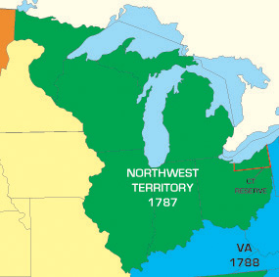
Accomplishments of the Articles of Confederation
Defeated the British in Revolutionary War (1776-1781)
Negotiated the Treaty of Paris with Britain in 1783—
Established the Northwest Ordinance of 1787
Which allowed the admission of 5 new states (Ohio, Indiana, Illinois, Michigan, Wisconsin)
Slavery was banned in this territory
Map of the land settled in the Northwest Ordinance of 1787
Notes:
Though they had many shortcomings, the Articles of Confederation cannot be considered a total failure. Under them, the government operated for nearly 12 years and managed to conduct a successful war of rebellion against what was then the most powerful country in the world.
Under the Articles, the United States also negotiated a very favorable peace treaty in which Britain formally recognized the United States and agreed to remove all British troops from U.S. territory. From the land granted to the United States as a result of the treaty, the country doubled in size, gaining land that today holds the states of Ohio, Indiana, Michigan, Illinois, Wisconsin, and part of Minnesota.
Many historians view the Northwest Ordinance as the most important piece of legislation to come out of this period. The Ordinance provided a method for admitting new states into the Union and for placing them on an equal footing with existing states. Thus, citizens from these new states would enjoy all the rights for which Americans had fought in the Revolution. The Ordinance even provided a bill of rights, something both the Articles and the original Constitution lacked.

Slide 6
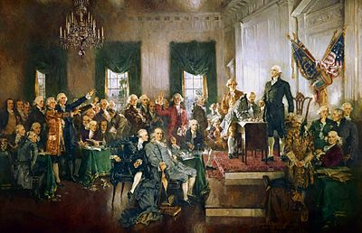
Failures of the Articles…
Shay’s Rebellion (1786-87)
Led by Continental Army captain Daniel Shays, thousands of Western Massachusetts citizens took up arms against the state government in objection of their land/property being taken by debt collectors
Similar protests occurred in other states
Shay’s Rebellion was put down, but national army had to rely on private funding (not seen as sustainable)
Most importantly, SR accelerated calls to reform the Articles, eventually resulting in the Philadelphia Convention of 1787, which elected George Washington as its president and produced the Constitution of the United States
Notes:
Inspired by “Regulators” of NC who took up arms against their royal governor in 1770-71 over similar issues

Slide 7
“The tree of liberty must be refreshed from time to time, with the blood of patriots and tyrants. It is its natural manure. Our convention has been too much impressed by the insurrection of Massachusetts; and on the spur of the moment, they are setting up a kite to keep the hen yard in order.”
Source: Thomas Jefferson on Shays’ Rebellion, November 1787

Slide 8
Select your delegates….
https://www.archives.gov/founding-docs/founding-fathers
Name
State
Background (age, occupation, experience)
Views on government/politics

Slide 9
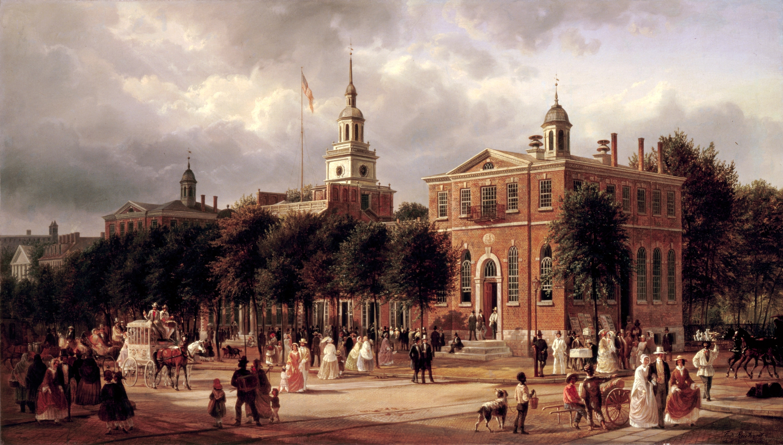
Constitutional Convention (1787):
Closed (not open to public) meeting between the delegates (representatives) from 12/13 states (RI not present).
Meeting took place in Philadelphia, Pennsylvania between May 25th and September 17th, 1787.
Most delegates wanted to simply amend (change) The Articles of Confederation.

Slide 10
Birth of a New Nation….
How much power should the new government have? Is there such a thing as too much centralized/federal control?
How much power should the individual states have? Is there such a thing as too much local control?

Slide 11
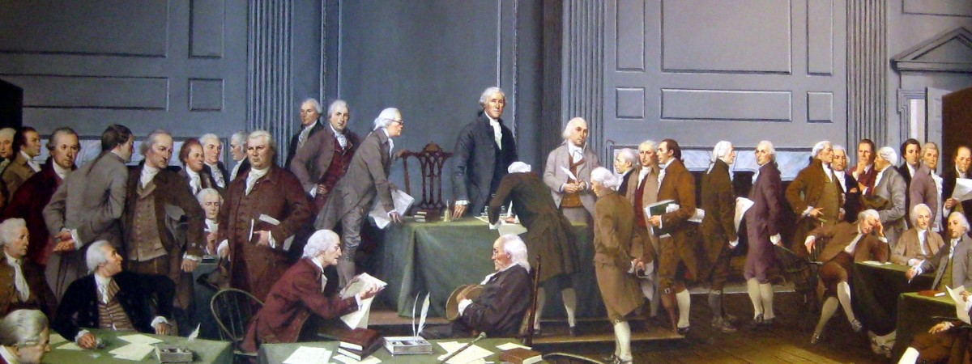
Notes:
They may look similar or come from similar backgrounds but their views on government were varied and divided (despite being on the same side during the Revolutionary War). For example, Patrick Henry was one of a few who refused to sign the Constitution.

Slide 12
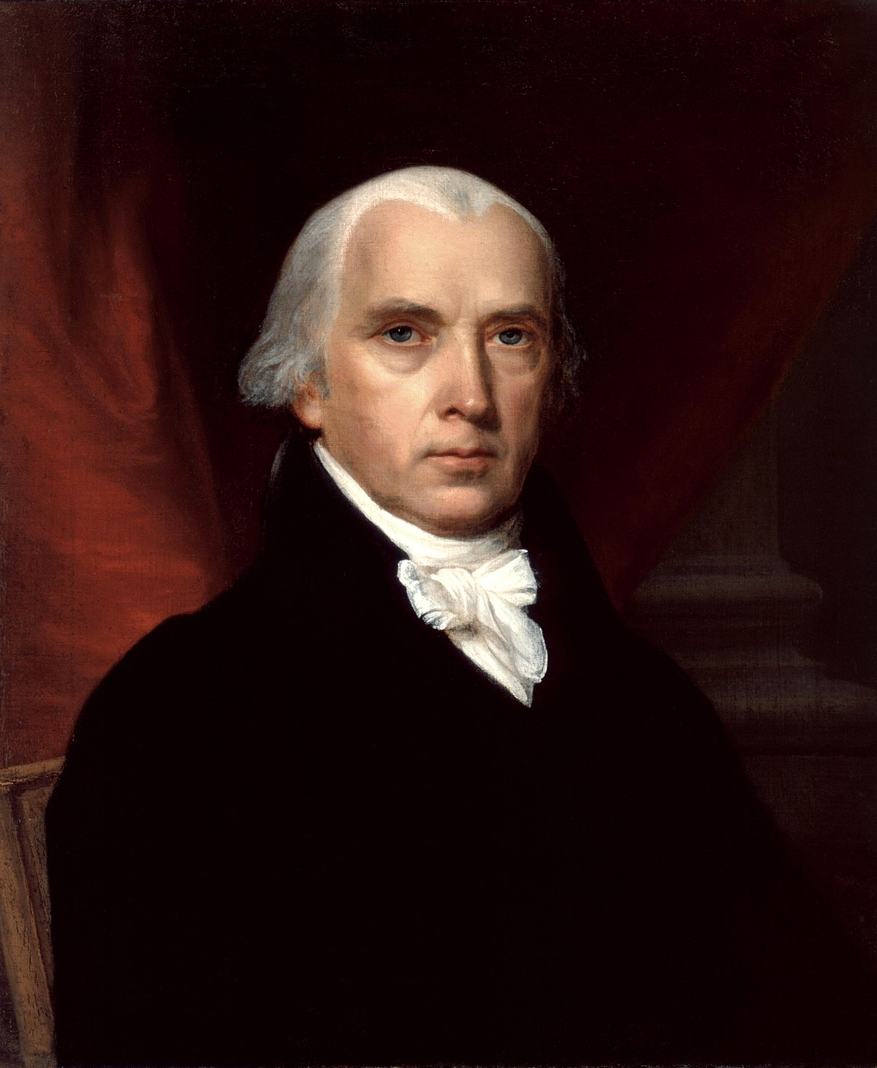
Delegates decided to scrap The Articles of Confederation and develop a new form of government.
Largely a set of compromises between states (agreed upon between May-September 1787)
*James Madison took very careful notes of the debates and discussions during the Convention.

Slide 13
Why the Articles must be amended…
“It does not provide against foreign attacks.”
“It does not secure Harmony to the States.”
“It is incapable of producing certain blessings to the States.”
“It cannot defend itself against encroachments.”
“It is not superior to State constitutions.”

Slide 14
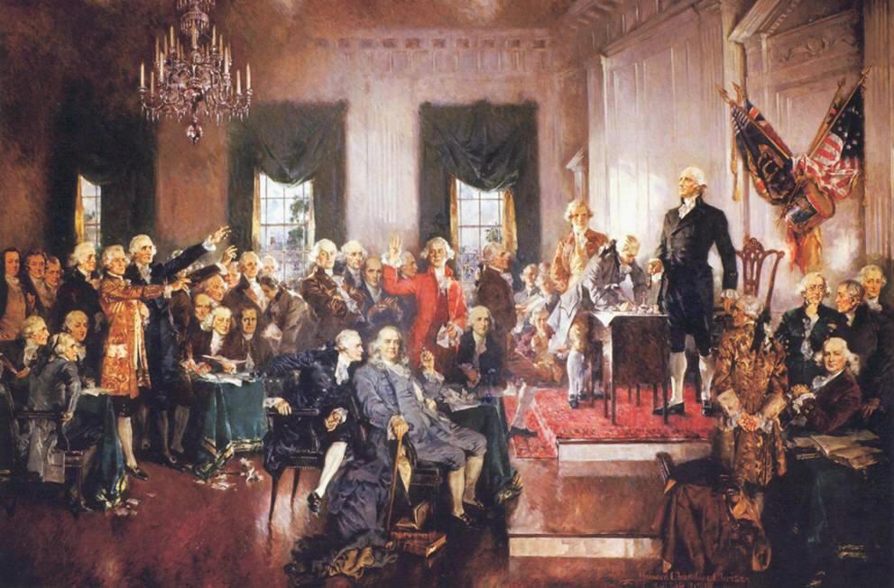
Major Arguments During The Constitutional Convention:

Slide 15
Representation between large and small states (by population?)
-debate so heated it almost put an end to the convention
2. Slavery (including slave representation?)
3. Bill of Rights (necessary?)
4. Elections (by the people?)
5. How to balance power between the executive branch (Presidency), Legislative Branch (Congress), and Judicial Branch (Supreme Court)?

Slide 16
1. Representation (Result: The Great Compromise)
Senate (small states):
2 Senators per state regardless of population.
100 Senators total (today)
**from New Jersey Plan
House of Representatives (large states):
Votes / delegates per state based on population.
435 members of the House (today).
**from Virginia Plan
Satisfied both large & small states with a bicameral congress

Slide 17
2. Slavery
Some delegates from northern states wanted to abolish (end) the slave trade and slavery.
Slavery had been abolished in several Northern/Middle states by 1787
Following the Revolution—more see slavery = tyranny?
Slavery abolished in VT (1777), MA (1783), and NH (1783); most other Middle and Northern states began gradual emancipation in this same period
One in ten American blacks was a free person by 1789
Freed for fighting for America and/or freed by masters
Most found in Upper South, Middle, and NE states (slavery will grow in the Deep South)
Many southern delegates threatened to leave the union if the slave trade or slavery were abolished in the U.S.

Slide 18
Results:
The word slavery does not appear in the Constitution.
“No Person held to Service or Labour in one State….”
Delegates agreed that:
Slave trade would not be discussed in Congress until 1808.
$10 tax would be placed on importation of each slave.
Runaway slaves would be returned to a state of slavery.

Slide 19
2a. Representation of the Slave Population:
Southern states wanted to count their slave population toward representation (giving them more delegates in the House of Republicans/more electoral votes for the presidency). Northern states did not.
Results:
Solution = The 3/5’s Compromise:
Every 5 slaves counted as 3 free people for both taxation and representation.

Slide 20
Bellringer (10/29/2019)
1. What is the main power for each branch of the U.S. Constitution?
2. Which branch do you believe was most important to the writers/founders of this new government?
Of 4,379 words:
Legislative (Congress)– 52%
Executive (Presidency)-23%
Justice (Supreme Court)-8%

Slide 21
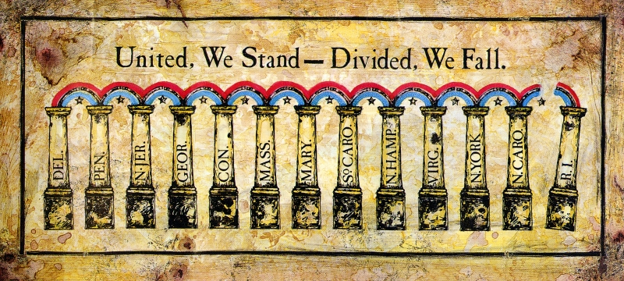
Ratifying the Constitution
Of 55 delegates from the 12 colonies, 39 signed the Constitution on September 17, 1787
3 refused to sign
States then voted on ratification thereafter
Required 9/13 states to approve
Divide between federalists (Pro-Constitution) /anti-federalists (anti-Constitution) existed in most states
By January 1788, only five states had signed
Notes:
Patrick Henry was one of the delegates who refused to sign

Slide 22
3. Bill of Rights (MA Compromise)
Many delegates (anti-Federalists) believed that a bill of rights needed to be added to the Constitution to protect individual rights and liberties (i.e. freedom of religion, speech)
Others (Federalists) argued that a Bill of Rights was not necessary and could actually limit certain individual liberties not listed in the BOR
Result: MA Compromise, 1788
States (including MA) agreed to sign the Constitution if a list of individual rights were added later

Slide 23
State | Date | Order | Votes For | Votes Against
Delaware | December 7, 1787 | 1 | 30 | 0
Pennsylvania | December 12, 1787 | 2 | 46 | 23
New Jersey | December 18, 1787 | 3 | 38 | 0
Georgia | January 2, 1788 | 4 | 26 | 0
Connecticut | January 9, 1788 | 5 | 128 | 40
Massachusetts | February 6, 1788 | 6 | 187 | 168
Maryland | April 28, 1788 | 7 | 63 | 11
South Carolina | May 23, 1788 | 8 | 149 | 73
New Hampshire | June 21, 1788 | 9 | 57 | 47
Virginia | June 25, 1788 | 10 | 89 | 79
New York | July 26, 1788 | 11 | 30 | 27
North Carolina | November 21, 1789 | 12 | 194 | 77
Rhode Island | May 29, 1790 | 13 | 34 | 32

Slide 25
A. Anti-Federalists:
Opposed the new Constitution.
Believed the Constitution would create too strong a central (federal) government that would threaten individual freedom.
Wanted individual freedoms (Bill of Rights) to be outlined in the Constitution.
Anti-Federalists were supported by men like Patrick Henry, Samuel Adams, and George Clinton, New York’s first governor.

Slide 26
B. Federalists:
Supported the new Constitution.
Argued that a much stronger central (federal) government was needed to preserve (keep) the United States.
Believed the U.S. would not survive under the Articles of Confederation.
Federalist Papers = a series of essays written in favor of the Constitution that were printed around the country.
Federalists papers were written by James Madison, Alexander Hamilton, and John Jay**

Slide 27
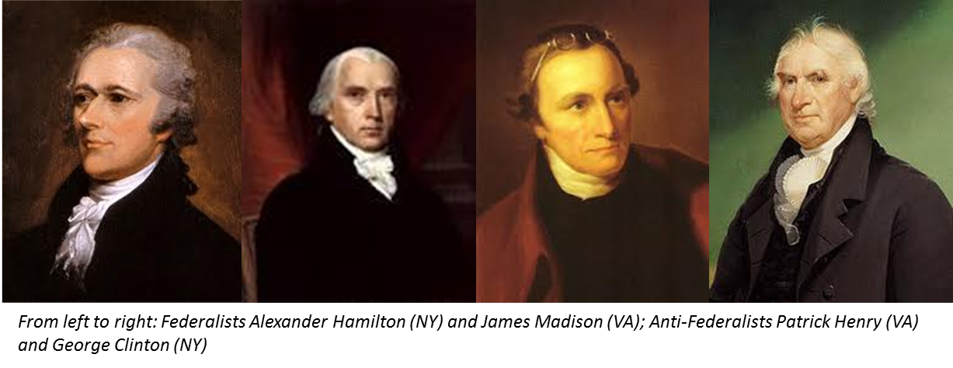

Slide 28
Both Federalists and Anti-Federalists are victorious
Federalists can say the Constitution was ultimately ratified by the states
Anti-Federalists can say the Bill of Rights was added to protect individual/states’ rights

Slide 29
“Show me that age and country where the rights and liberties of the people were placed on the sole chance of their rulers being good men without a consequent loss of liberty! I say that the loss of that dearest privilege has ever followed, with absolute certainty, every such mad attempt.”
– Patrick Henry, 1788

Slide 30
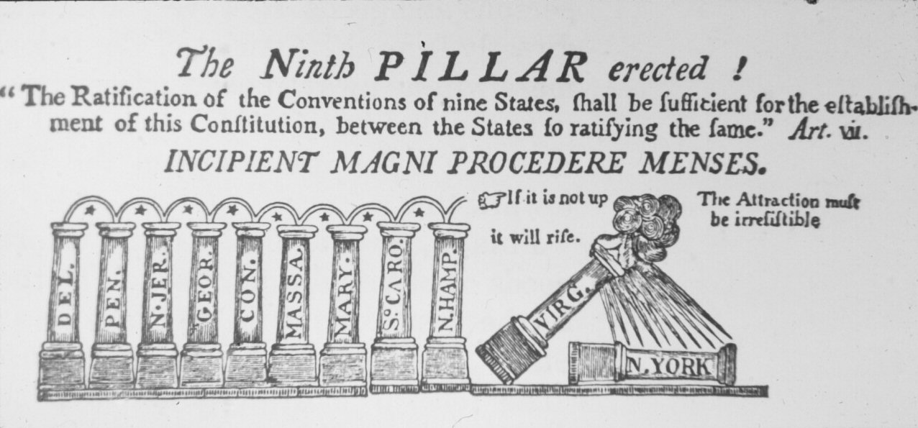

Slide 31
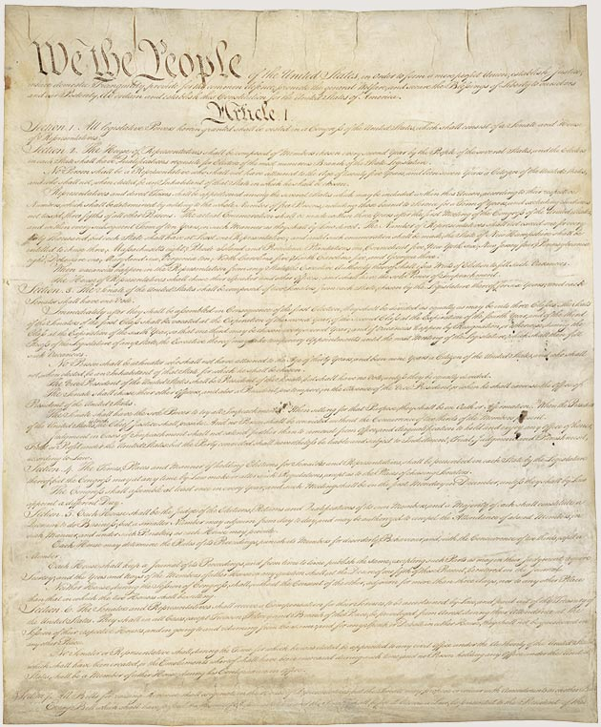
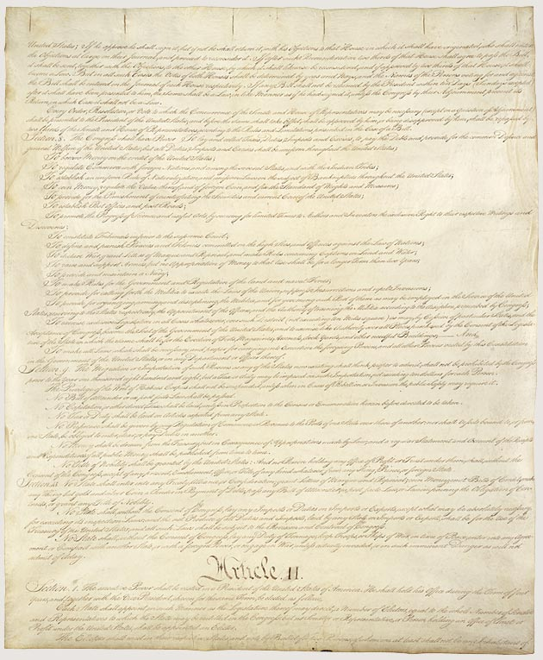

Slide 32
